Slide 1
Chapter Six
Data Communications and Computer Networks
Notes:
Data communications deals with the exchange of information in a reliable and efficient manner between two nodes at an arbitrary distance.
Reliability: Produces the same or identical result repeatedly for the same input.
Reliability=>Repeatability or Consistency
Rely: trust fully; have faith in; be dependent on ;;
Efficient: With minimum cost, without wasteful use of resource
Networking deals with the technology and architecture of communications networks used to interconnect communicating devices. LANs, WANs, and the building components (devices).
There is no fundamental difference between data processing (computers) and data communications (transmission and switching equipment).
There is always encoding, moving, and decoding.

Slide 2
Agenda
Data Communications
Data transmission
Communication channels
Types of transmission mode
Components of Data communications
Applications of Data Comm.
Computer Networks
Classification of networks
Networking components (devices, software, …)
Distributed systems
Notes:
Computer networking is about: Data processing (computers) and data communications (transmission and switching equipment).
Merging of computer and communications technologies – no geographical barrier

Slide 3
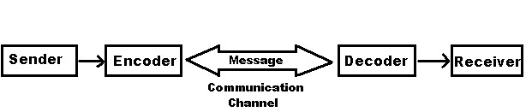
Data Communications
The word data refers to information presented (encoded) in whatever form is agreed upon by the parties creating and using the data.
Data communications is the exchange of data between two devices via some form of transmission medium such as a wire cable.
Notes:
Give examples : → The situation when I speak to you. → Radio and Television broadcast
Nodes can be PC’s, workstations and other “specialized” computers such as hubs, switches and routers. The nodes can be geographically located anywhere.
Examples of encoder and decoder are Modem and NIC.
Data, transmission, Protocols;

Slide 4
Communications Cont…
Data Communications
Transmission of signals
Encoding (conversion, encrypting, modulating…), interfacing (modem, NIC,.), signal integrity, multiplexing, compression, etc.
To be transmitted data must be converted to electrical or electromagnetic signal.
The methods include electrical signals carried along a conductor, optical signals along an optical fiber, and electromagnetic signals (waves) through space
The two major approaches to greater efficiency in using a shared medium for data communication are multiplexing and compression.
Notes:
Multiplexing is simultaneous transmission of several signals along a single high speed channel of communication.
Example the tele box at your neighborhood for voice telephone.
Interface is a device or program for connecting two items of software or hardware. Example NIC, modem.
Encoding: Converting in to a coded form
Signal Integrity: The state of being whole; Not corrupted during transmission
Using frequency division multiplexing (FDM), a coaxial cable can carry over 10,000 voice channels simultaneously (analog). In contrast, TDM can be handled entirely by digital electronics,
so it has become far more widespread in recent years (only for digital data). Tannenabaum, 5th.
Coaxial cable is used to transmit both analog and digital signals.

Slide 5
Data communication four basic terms
Data: A collection of facts in raw forms that become information after processing.
Signals: Electric or electromagnetic (radio and light waves) encoding of data.
Signaling: Propagation of signals across a communication medium.
Transmission: Communication of data achieved by the processing of signals.
Notes:
Data as entities that convey meaning, or information.
Signals are electric or electromagnetic representations of data (Information is embedded in signals).
Signaling is the physical propagation of the signal along a suitable medium.
Signaling is about moving the signal along a medium.
Transmission is the communication of data by the propagation and processing of signals.
Propagation = Broadcasting
Data: voice received by a mic; Signal: mic converts voice to electrical signal; Signaling; the sender prepares, amplifies, and pushes the signal through the medium; Transmission: signifies the whole process of communication.

Slide 6
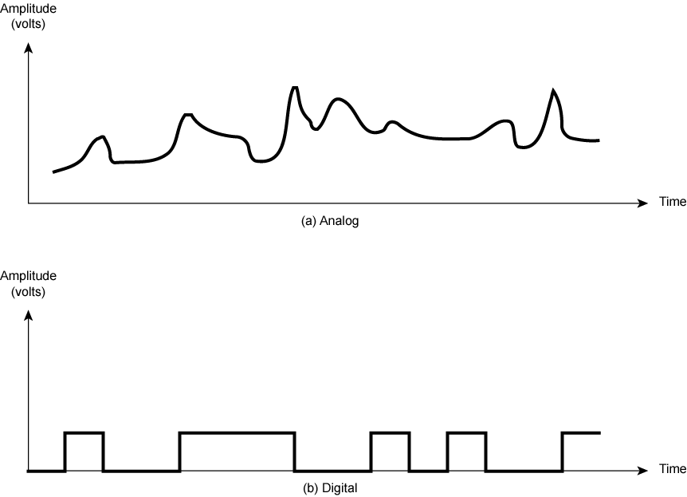
Analogue & Digital Signals
Continuous values within some interval
e.g. sound, video
Detecting and correcting distortion due to noise (introduced during transmission) is relatively easy in digital transmission
Discrete values
e.g. text, integers
The principal advantages of digital signaling are that it is generally cheaper than analog signaling and is less susceptible to noise interference.
Notes:
Signals are electric or electromagnetic representations of data.
Digital signals are relatively easy to store and manipulate electronically.
→ It is relatively very easy to compress, encrypt, store, copy, and manipulate a digital signal.
Wires and wireless channels (fiber included) carry analog signals such as continuously varying voltage, light intensity, or sound intensity.
The process of converting between bits and signals that represent them is called digital modulation. Then we will consider schemes that regulate the amplitude, phase, or frequency of a carrier signal to convey bits.
Impairment: Weakening or damaging
Attenuation: Amplifiers and Repeaters are used respectively
Distortion, and Noise (thermal noise and crosstalk)

Slide 7
Analogue & Digital Signals
A modem converts sequences of binary voltage pulses into an analog signal by encoding the digital data onto a carrier wave through a process called modulation.
Three characteristics of analog carrier waves that can be altered are frequency, amplitude, and phase.
Examples of analog values: Sound, Temperature, Pressure, Light, Video
Signals are electric or electromagnetic representations of data.
Notes:
Signals are electric or electromagnetic representations of data.
Signals: Electric or electromagnetic (radio and light waves) encoding of data.
Wires and wireless channels (fiber included) carry analog signals such as continuously varying voltage, light intensity, or sound intensity.
The process of converting between bits to signals that represent them is called digital modulation.
Digital signals are relatively easy to store and manipulate electronically.
→ It is relatively very easy to compress, encrypt, store, copy, and manipulate a digital signal.
Once sent, the signal propagates down the wire (or other medium). At the other end, the
receiver converts it into bits by sampling the signal at regular intervals of time.
For long-distance transmission of analog signals, amplifiers are needed every few kilometers, with closer spacing required if higher frequencies are used. The usable spectrum for analog signaling extends to about 500 MHz; For digital signaling, repeaters are needed every kilometer or so, with closer spacing needed for higher data rates.
Some transmission media, such as optical fiber and unguided media, will only propagate analog signals.

Slide 8
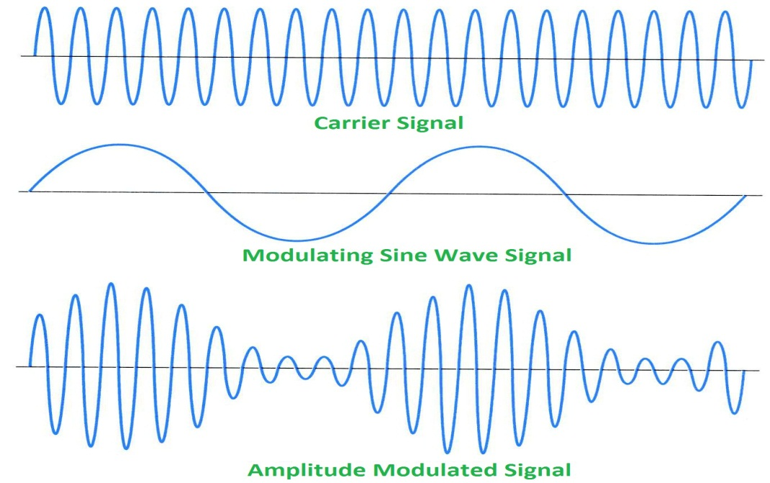
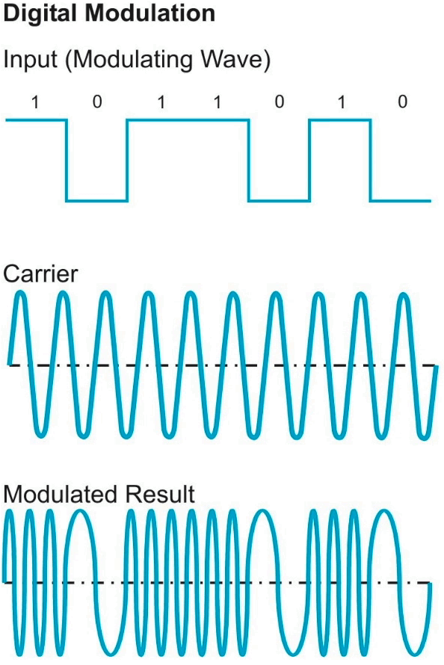
Analogue & Digital Signals Cont.
Processing of signals for transmission
Notes:
Digital signals are relatively easy to store and manipulate electronically.
→ It is relatively very easy to compress, encrypt, store, copy, and manipulate a digital signal.
Once sent, the signal propagates down the wire (or other medium). At the other end, the
receiver converts it into bits by sampling the signal at regular intervals of time.
Speed of electromagnetic radiation in free space (c) = 3.00 x 10⁸ m s⁻¹
Planck’s constant (h) = 6.63 x 10⁻³⁴ J s
Energy = h * f (energy of electromagnetic wave) quantum energy of a photon

Slide 9
Bandwidth of transmission
Telecommunications (analog bandwidth): range of radio frequencies: (in hertz) used in radio or telecommunications transmission and reception.
Computing (digital bandwidth): communications capacity: the capacity of a communications channel, for example, a connection to the Internet, often measured in bits per second (bps).
a data transmission rate; the maximum amount of information (bits/second) that can be transmitted along a channel. Broader frequency range and/or wider bandwidth results in transmission of more data per unit time.
Bandwidth is limited by the type of transmission medium
Notes:
Bandwidth refers to the maximum amount of information in bits per second (or range of frequencies) that a particular channel can transmit. Patricia Wallace, Page 75.
In general, the greater the bandwidth of the signal, the greater its information-carrying capacity. The Data rate is limited by the bandwidth, the presence of impairments, and the error rate that is acceptable. Read Tannenbaum, 5th , page 93.
Impairment: Weakening or damaging
Attenuation: Amplifiers and Repeaters are used respectively
Distortion, and Noise (thermal noise and crosstalk)
In telephone networks, this frequency band typically has a width of 4 kHz. Services with more bandwidth than standard telephone service are sometimes called broadband, although the term really is more of a marketing concept than a specific technical concept.
The width of the band is called, not surprisingly, the bandwidth. FM radio stations also use FDM to
share microwave frequency spectrum.

Slide 10
Data transmission
A basic communication system consists of :
Example - consider a radio broadcast.
In this case
the broadcast tower (antenna) is the transmitter,
the radio is the receiver and
the transmission medium is free space.
Transmitter
Receiver
Information channel
Notes:
Often telecommunication systems are two-way and devices act as both a transmitter and receiver or transceiver.
For example, a mobile phone is a transceiver.

Slide 11
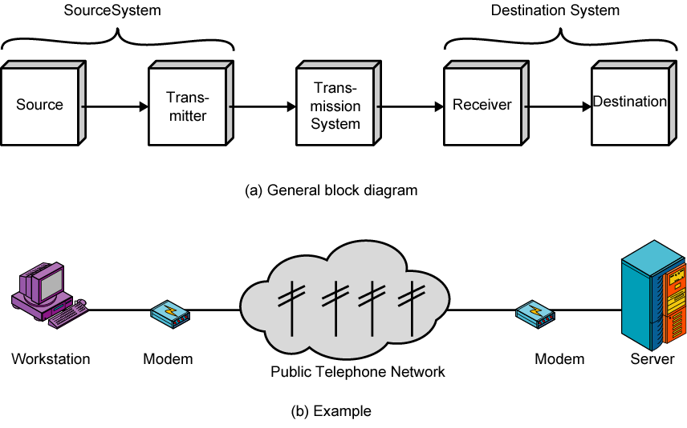
Simplified Communications Model - Diagram
Notes:
A model hides complexity and simplifies explanation. A model is a simplified form of a complex reality.
The fundamental purpose of a communications system is the exchange of data between two parties.
Source : Produces the data to be transmitted. Examples are telephones and personal computers.
Transmitter : Transforms and encodes the generated data in such a way as to produce electromagnetic signals that can be transmitted across some sort of transmission system. Examples are modems and NICs.
Transmission System : This can be a single transmission line (medium) or a complex network connecting source and destination. Examples are wire, air, or the Internet.
Receiver : Accepts the signal from the transmission system and converts it into a form that can be handled by the destination device. Examples are modem and NIC.
Destination : Takes the incoming data from the receiver and do something with it. Examples are telephones and computers.

Slide 12
A Communications Model
Source
generates data to be transmitted
Transmitter (encoding is done here)
Converts data into transmittable signals
Transmission System
Carries data
Receiver (decoding…)
Converts received signal into data
Destination
Takes incoming data
Notes:
A model hides complexity and simplifies explanation.
A model is a simplified form of a complex reality.
A Transmitter also amplifies and strengthens the signal for transmission.
Example should go here!

Slide 13
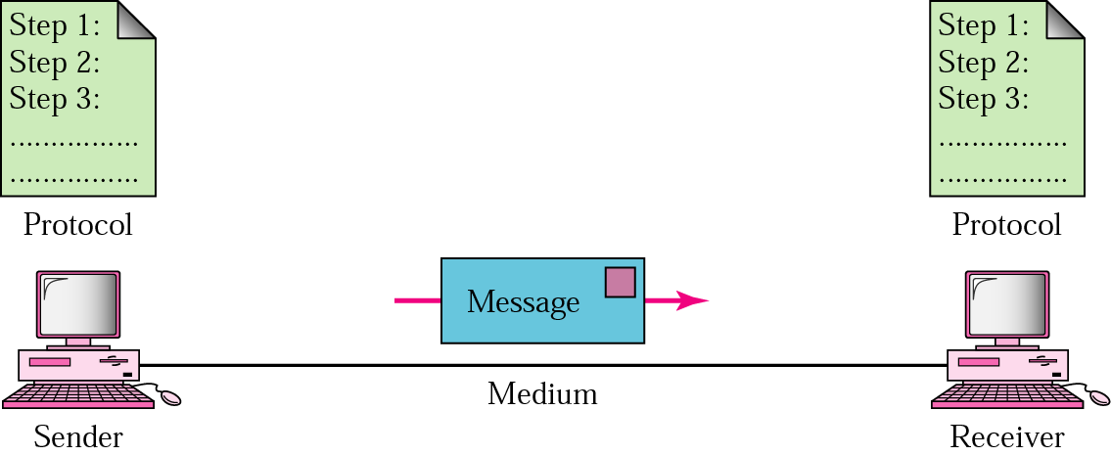
Five Components of Data Communication
Message
Sender
Receiver
Medium
Protocol
Notes:
As seen from different perspective; A little bit deeper!
A protocol defines the format and the order of messages exchanged between two or more communicating entities, as well as the actions taken on the transmission and/or receipt of a message or other event.
Message : Content (data)
Impairment: Weakening or damaging
Attenuation: Amplifiers and Repeaters are used respectively
Distortion, and Noise (thermal noise and crosstalk)
Collision, what to do?

Slide 14
Communication Protocols
The procedure of data transmission in the form of software is commonly called protocol.
Data communication software is the software that enables us to communicate with other systems.
The data communication software instructs computer systems and devices as to how exactly data is to be transferred from one place to another.
Notes:
A protocol defines the format and the order of messages exchanged between two or more communicating entities, as well as the actions taken on the transmission and/or receipt of a message or other event.

Slide 15
Data transmission software or protocols (functions)
The data transmission software or protocols performs the following functions for the efficient and error free transmission of data
Data sequencing: A long message to be transmitted is broken into smaller packets of fixed size and a unique sequence number is given for every packet.
Data Routing: It is the process of finding the most efficient route between source and destination before sending the data.
Notes:
Fragmentation and Reassembly.
A protocol is synonymous with rule-set. It consists of a set of rules that govern data communications.
It determines what is communicated, how it is communicated and when it is communicated.
The key elements of a protocol are syntax, semantics and timing.

Slide 16
Cont…
Flow control: enables a receiver to regulate the flow of data from a sender so that the receiver’s buffers do not overflow. Regulates the process of sending data between fast sender and slow receiver.
Error Control: Error detecting and recovering is one of the main function of communication software. It ensures that data is transmitted without any error and loss. (retransmit if no ack.)
Opening/closing comm. Lines, message switching, circuit switching, multiple use of comm. lines, …
Transmission upon agreed encoding rules and protocols . Example is
TCP/IP; TCP/IP means Transmission Control Protocol/Internet
Protocol
Notes:
Flow control: The sending station must not send frames at a rate faster than the receiving station can absorb them.
Makes sure that neither side of a connection overwhelms the other side by sending too many packets too fast. End systems are alerted to the existence of severe congestion when they stop receiving acknowledgments for the packets they have sent.
Error control: Bit errors introduced by the transmission system should be corrected.
Compression and Encryption can also be performed by Comm. Software.
Impairment: Weakening or damaging
Attenuation: Amplifiers and Repeaters are used to boost the signal
Distortion, and Noise (thermal noise and crosstalk)
Collision, what to do?

Slide 17
Elements of a Protocol (Communications Software)
Syntax
Structure or format of the data blocks
Indicates how to read the bits - field delineation
Semantics
Interprets the meaning of each section of bits
Knows which fields define what action
Includes control information for coordination and error handling
Timing
When data should be sent
Speed at which data should be sent or speed at which it is being received.
Includes speed matching and sequencing
Protocol specification (precise syntax and semantics for interoperability)
Notes:
Delineate: to describe or explain something in detail.
Syntax: Concerns are format of the data blocks.
Example: 8-bits address of sender, 8-bits address of receiver
Semantics: Includes control information for coordination and error handling
Example: telling whether the address is a route to be taken or final destination of the message
Timing: Includes speed matching and sequencing
This includes the format of the protocol data units exchanged, the semantics of all fields, and The allowable sequence of PDUs. PDU : Protocol Data Unit
Protocol specification (precise syntax and semantics for interoperability)

Slide 18
Protocol Concepts
Protocols are sets of rules.
What do you want to do? (Application)
Where are you going? (Addressing)
How do you get there? (Media types, Routing)
Did you get there? (Acknowledgments, Error checking)
A protocol defines what is communicated, how it is communicated, and when it is communicated.
Notes:
Checksum and Hashing can be explained here!

Slide 19
We can group protocol functions into the following categories:
• Encapsulation (data + control information)
• Fragmentation and reassembly
• Connection control
• Routing & Ordered delivery
• Flow control
• Error control
• Addressing (IP address, MAC, Port number, etc.)
• Multiplexing
• Transmission services (encryption, compression,…)
Notes:
The five components of data communication are: sender, receiver, message, medium, & protocol
A protocol defines the format and the order of messages exchanged between two or more communicating entities, as well as the actions taken on the transmission and/or receipt of a message or other event.
Functions of a protocol: data sequencing, data routing, flow control, error control, opening & closing communication lines => for efficient and reliable transmission
Control information can be address information and error detecting code.
A protocol may need to divide a block received from a higher layer into multiple blocks of some smaller bounded size. This process is called fragmentation.
.

Slide 20
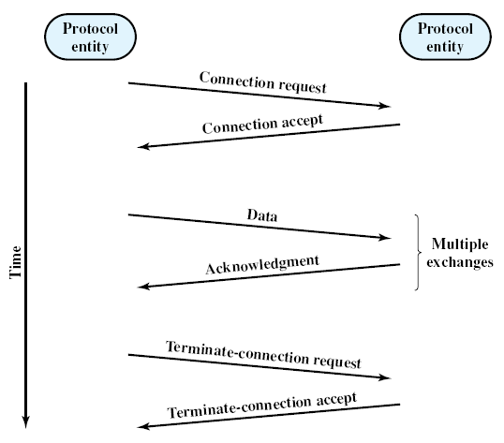
The Parts of a Connection-Oriented Data Transfer
Connection control function of a protocol
Three parts: Establish connection, Exchange data, Terminate connection
Notes:
Functions of a protocol: data sequencing, data routing, flow control, error control, opening & closing communication lines => for efficient and reliable transmission
Examples are: Telephone call and Client Server Communication.
Connection oriented and Connectionless communications
This is TCP type of connection
This is a kind of Synchronous Communication (Dedicated line is established).
A kind of live communication.
Similar to a telephone call or two people in some form of conversation.
At the end of communication, the connection is teared down or broken or terminated.
Three phases occur: Connection establishment, Data transfer, Connection termination

Slide 21
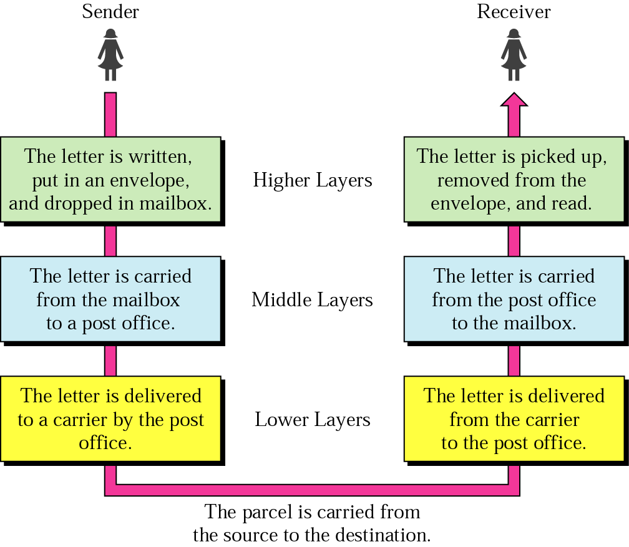
Layered Tasks in Communications
An example from the everyday life (Sending a letter)
Hierarchy of
Services
Notes:
Because data communication is a complex phenomena, we use layering to simplify and manage it.
Functionality of the layers can be changed as long as the service provided to the layer above stays unchanged.
Each layer provides services to the next higher layer and implements a protocol to the peer layer in other systems.
This is Connectionless type of communication (UDP).
We have other architectures for other problem domains.
Like pipes and filters, objects as in Object Orientation, repositories, interpreters, etc.

Slide 22
Why layered communication?
To manage (reduce) complexity of communication task by splitting it into layers of smaller tasks
Functionality (implementations) of the layers can be changed as long as the service provided to the layer above stays unchanged
makes maintenance & updating easier
Simplifies teaching and learning
Each layer has its own task (service)
Each layer has its own protocol
Notes:
Facilitates team work. Each team can work on different layers at the same time.
Makes maintenance, updating, and possibly manufacturing easier.
When done based on specifications (standards) leads to Interoperability.
Facilitates modular engineering (different teams work on different modules)
The physical layer specifies how to transmit bits across different kinds of media as electrical (or other analog) signals.

Slide 23
OSI REFERENCE MODEL
Notes:
Each layer has its own task (service)
Each layer has its own protocol (or sets of protocols)
Layer 3 and Layer 4 are components of the OS (implemented by the OS)
Application : HTTP, FTP, SMTP (Browser applications)
Presentation : Provides encryption and compression of data
Session : Synchronizes dialogue
Transport : End-to-end error free delivery of entire message (many Segments)
Network : End-to-end delivery of packets
Data Link : Provides reliable transit of data across a physical link by using the MAC addresses
Physical : The layer that actually interacts with the transmission media
Application Layer : Session ID (Process ID)
Transport Layer : Port number
Network Layer : IP Address (Logical Address)
IP address = Network address + Host address
Data Link Layer : MAC Address (Physical Address)

Slide 24
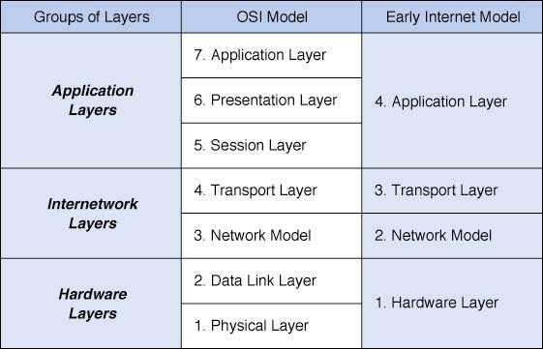
TCP/IP
Layer
Layer
(Link Layer)
Network Models: OSI is Developed by ISO * standards are essential for interoperability
Notes:
Which layers of the OSI model are components of the Operating System?
Ans. Layer 3 and 4.
A model is an abstraction of complex reality. Abstraction using layering.
Each layer provides service to a layer above it.
Port number, IP address, and MAC address.
Users are uniquely identified by their session ID.
OSI : Open System Interconnection
ISO = International Organization for Standardization.
ITU, IEEE, IETF, ANSI (American National Standards Institute)
ITU : International Telecommunication Union
IETF : Internet Engineering Task Force
Institute of Electrical and Electronics Engineers
World Wide Web Consortium (W3C)

Slide 25
Physical Layer
lowest level layer
Specifies
the characteristics of the transmission medium
Nature of the signals
Data rate
Notes:
And the highest layer prepares the message.
What is the highest layer in computer communication? Application layer!
Twisted pair, Coaxial cable, Fiber optic cable, wireless (Infrared, Bluetooth, Wi-Fi, Microwave, Satellite)?
Electrical, Electromagnetic, Baseband, Broadband, Multiplexed?

Slide 26
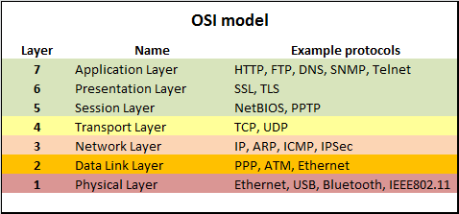
Each layer has its own protocol
, DHCP
Each layer provides service to a layer above it
Reading Assignment : Read about Ethernet Protocol (CSMA/CD)
Notes:
Application Layer >> Message
Transport Layer >> Segments PPP: Point to Point Protocol
Network Layer >> Packets SNMP: Simple Network Management Protocol
Data Link Layer >> Frames TLS (transport layer security), SSL (secure sockets layer)
Physical Layer >> Bits PPTP: Point to point tunneling protocol (used to implement VPN)
Medium >> signals
The link layer is concerned with how to send finite-length messages between directly connected computers with specified levels of reliability. Ethernet and 802.11 are examples of link layer protocols.
The network layer deals with how to combine multiple links into networks, and networks of networks, into internetworks so that we can send packets between distant computers. This includes the task of finding the path along which to send the packets.

Slide 27
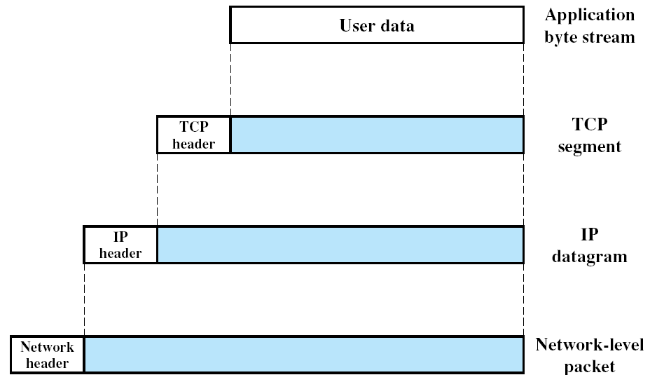
Data + Control Information = Encapsulation
Message
Segment
Packet
Frame
Protocol Data Units (PDUs) in the TCP/IP Architecture
Notes:
TCP is implemented only in the end systems; it keeps track of the blocks of data
to assure that all are delivered reliably to the appropriate application.
IP is implemented in all of the end systems and the routers. It acts as a relay to move
a block of data from one host, through one or more routers, to another host.
Header control information is to be used by the peer (TCP) protocol entity at the destination host.
Examples of items in the TCP header include: Source & Destination ports, Segment sequence number, and Checksum.
The sending TCP includes a code (checksum) that is a function of the contents of the remainder of the segment.
Demonstrate the Checksum.
Datagrams are smallest data units.

Slide 28
Data Transmission Modes (Based on direction of data flow)
Simplex System
Only one device on a link can transmit; the other can only receive. It is one way communication. Use the entire capacity of the channel to send data
Ex. Telemetry, Broadcast radio, keyboards
Half Duplex
Device can send/receive but not simultaneously.
Ex. Marine Radio, Walky-talky (Police Radio)
Full Duplex
A system that allows communication in both directions simultaneously and synchronously. Use of full-duplex communication improves efficiency.
Signals going in either direction sharing the capacity of the link
The medium is carrying signals in both directions at the same time.
Ex. Telephone
Notes:
Data transmission can be done in different modes (based on direction of data flow).
Simplex : like a one-way street.
Half Duplex : Like a single-track railroad line.
Full Duplex : Like a two-way road.
Telemetry: Transmit (readings) to a distant receiving set or station.

Slide 29
Communication Channels
A channel is a path between two communication devices
Channel capacity: How much data can be passed through the channel, bits/sec or hz (frequency-range)
Also called channel bandwidth
The smaller the pipe the slower the data transfer!
Analog bandwidth of a medium is expressed in hertz;
Digital bandwidth of a medium is expressed in bits per second.
Consists of one or more transmission media
Materials carrying the signal
Two types:
Physical: wire or cable (Guided)
Wireless: air (or space or water) (Unguided)
Notes:
Each physical media has its own niche in terms of bandwidth, delay, cost, and ease of installation and maintenance
Niche : market share or function
The channel (transmission medium) is connected directly or through a modem to the physical layer.

Slide 30
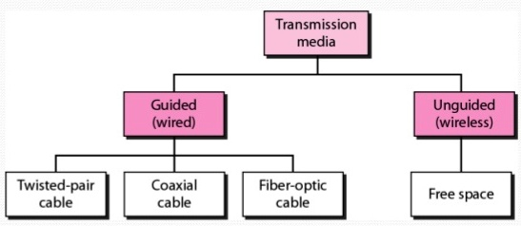
Transmission Channel (Media) Cont.
Two main categories:
Guided (Physical)
Twisted-Pair cables:
Unshielded Twisted-Pair (UTP) cables
Shielded Twisted-Pair (STP) cables
Coaxial cables
Fiber-optic cables
Power line
Unguided (Wireless)
Wireless transmission, e.g. radio, microwave, infrared (infrared can not be used outdoors at day time due to sunshine), sonar (echo-location finding system in water, using sound pulses)
Each physical media has its own niche in terms of bandwidth, delay, cost, and ease of installation and maintenance
Notes:
Power-line communication (PLC) is a communication method that uses electrical wiring to simultaneously carry both data and electric power. It is also known as power-line carrier, power-line digital subscriber line (PDSL), mains communication, power-line telecommunications, or power-line networking (PLN).
Unguided transmission is propagation through air, vacuum, and seawater.
Sonar= The method of echolocation finding in air and water by animals such as bats and whales!

Slide 31
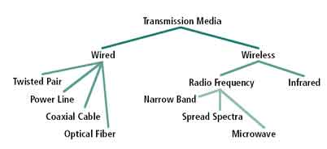
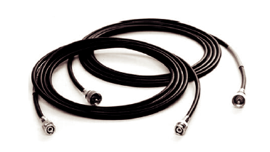
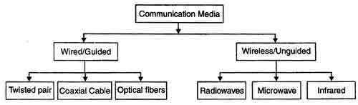
Coaxial Cable
Information channel or media Cont’d …
A thinnet coaxial cable.
Notes:
Power-line communication (PLC) is a communication method that uses electrical wiring to simultaneously carry both data and electric power. It is also known as power-line carrier, power-line digital subscriber line (PDSL), mains communication, power-line telecommunications, or power-line networking (PLN).

Slide 32
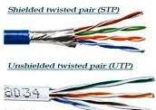
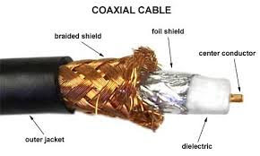
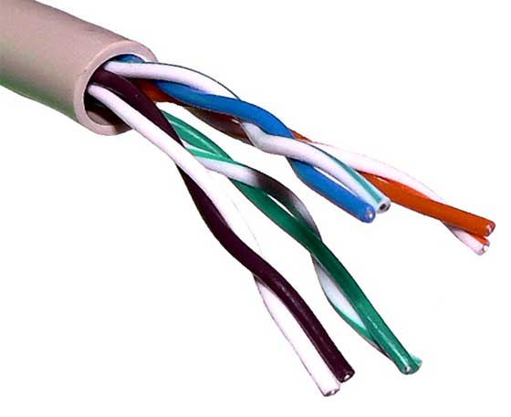
Physical Media (Guided Channel)
A tangible media
Twisted-pair cable:
One or more twisted wires bundled together (why twisted?)
Made of copper
Coax-Cable:
Consists of single copper wire surrounded by three layers of insulating and metal materials
Typically used for cable TV
Fiber-optics:
Strands of glass or plastic used to transmit light
Very high capacity, low noise, small size, less suitable to natural disturbances, highly secure
UTP
Notes:
Noise can be created due to heat, for example.

Slide 33
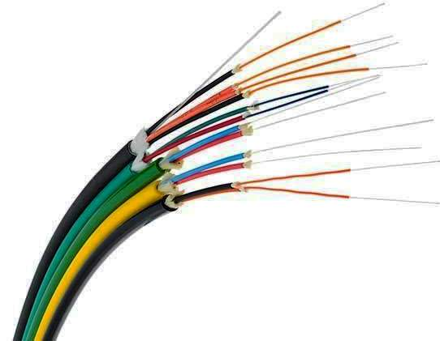
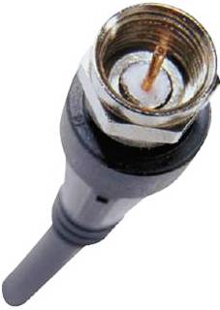

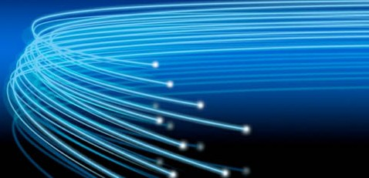
Information channel Cont’d …
Guided
Cable transmission (Attenuation, Distortion & noise) (reduce the strength & change the form during transmission)
Fibre-optics
10GBPS and greater, long distance
Coaxial
10MBPS and greater, 1Ghz (analog)
Twisted pair (Shielded Twisted Pair – STP - Cable)
10 to 1000MBPS, 100Meter (LAN)
Twisted pair (unshielded twisted pair-UTP)
less interference protection and lower data rate than STP
Cross talk problem
Coaxial cable connector
Fiber optic cables
Notes:
A common source of noise is EMI (electromagnetic interference) EMI/RFI.
Thermal noise and cross talk are two types of noises.
Attenuation=reduce the strength due to long distance transmission
Distortion=change the form during transmission
Distortion means that the signal changes its form or shape. Distortion mainly occurs in a composite signal made of different frequencies.

Slide 34
Fiber-Optic Cable
Fiber-optic cables use light signals for data transmission.
Either laser or other light producing mechanism, such as light emitting diodes (LEDs), are used as the source of light.
Photo diodes (photo detectors) are used as receiving devices
Using a laser is more dependable, but more costly, so most fiber-optic networks use LEDs as the source of light.
Reading Assignment: Read about Microwave, Infrared & Bluetooth wireless transmissions
Notes:
An optical transmission system has three key components: the light source, the transmission medium, and the detector.
The current practical limit of around 100 Gbps is due to our inability to convert between electrical and optical signals any faster.
Fiber optics are used for long-haul transmission in network backbones, high speed LANs. (although so far, Copper has always managed to catch up eventually), and high-speed Internet access such as FttH (Fiber to the Home).
Fidelity : The degree of exactness with which something is copied or reproduced.
In relation to Li-Fi (Light Fidelity).

Slide 35
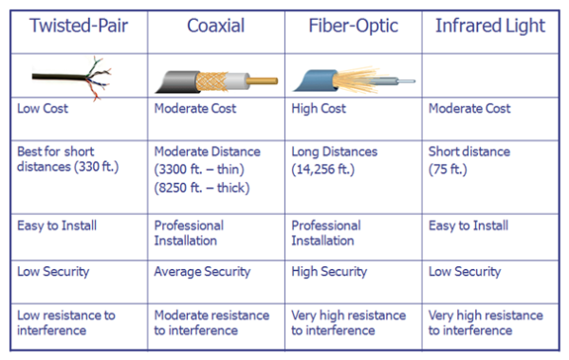
Physical Transmission Media and wireless Infrared
Characteristics Comparison
Wireless
Notes:
1 foot = 30.48 cm
Remote Control Devices use infrared transmission.

Slide 36
Communication Satellite
A communication satellite is a microwave relay station placed in outer space.
In satellite communication, microwave signal is transmitted from a transmitter on earth to the satellite at space.
The satellite amplifies the weak signal and transmits it back to a receiver on earth.
The main advantage of satellite communication is that it is a single microwave relay station visible from any point of a very large area.
Notes:
Broadcast, multicast, and unicast

Slide 37
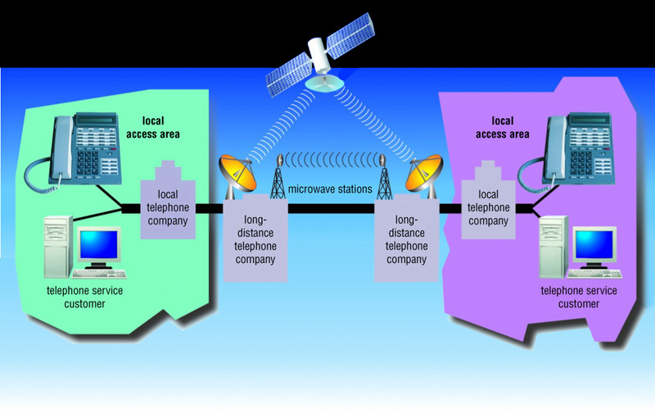
Microwave Communications Example: For Telephone Networks
Notes:
Broadcast, multicast, and unicast

Slide 38
Communication Satellite Cont.
Unguided or Wireless
Microwave
Satellite (Example; GEO or Geostationary)
A man made spacecraft, about 23,000 miles (37,000 km) above the earth (speed about 10,000 km/hr?); GEO (geosynchronous earth orbiting); 3 of them are enough to cover the whole world.
500 MHZ bandwidth (analog);
The data transmission rate is 16 Giga bits per second. They are mostly used to link big metropolitan cities;
Receives analog and digital signals, amplifies the signal and retransmits back to earth.
How are satellites put into orbit?
Notes:
Escape Velocity
One mile is approximately 1.609 kilometres.
Data transmission rate is a function of bandwidth => Directly proportional

Slide 39
Microwave (Unguided)
Microwave system uses very high frequency radio signals (1Ghz-500Ghz) to transmit data through space.
What is the speed of a radio signal?
The transmitter and receiver of a microwave system should be in line-of-sight because a radio signal cannot bend.
Along the earth’s surface very long distance transmission is not possible without using repeaters (due to line of sight and earth’s curvature).
In order to overcome the problem of line of sight and power amplification of weak signals (due to attenuation), repeaters are used at intervals of 25 to 30 kilometers between the transmitting and receiving end.
Notes:
Why high frequency?
Frequency range used in microwave transmission : 1ghz ~ 500ghz
Speed of electromagnetic radiation in free space (c) = 3.00 x 10⁸ m s⁻¹
Planck’s constant (h) = 6.63 x 10⁻³⁴ J s
Energy = h * f (energy of electromagnetic wave) quantum energy of a photon

Slide 40
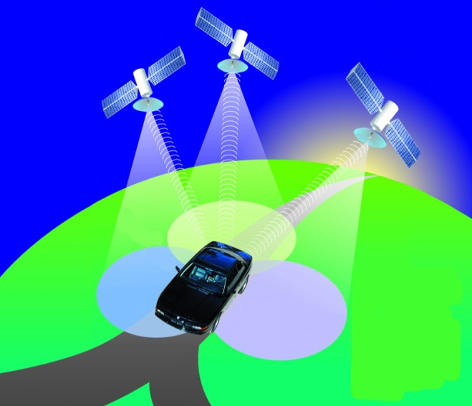
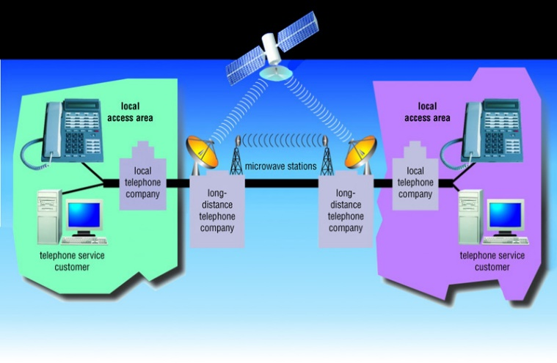
Wireless Transmission Cont’d…
Microwaves
Radio waves providing high speed transmission
They are point-to-point (can’t be obstructed)
Used for satellite communication
Infrared (IR)
Wireless transmission media that sends signals using infrared light- waves; 16Mbps; point-to-point
Example, electronic device remote controllers
Bluetooth: envisioned for a cable-free world
Radio frequency technology; 2Mbps
Can pass over obstacles
Can detect other nearby Bluetooth devices
Wireless earphones and other short distance wireless devices
Notes:
Wi-Fi is to a wireless LAN while Bluetooth is to Wireless PAN.
Bluetooth operates over a short range, at low power, and at low cost. It is essentially a low-power, short-range, low-rate “cable replacement” technology for interconnecting notebooks, peripheral devices, cellular phones, and smartphones. Bluetooth networks are sometimes referred to as wireless personal area networks (WPANs).

Slide 41
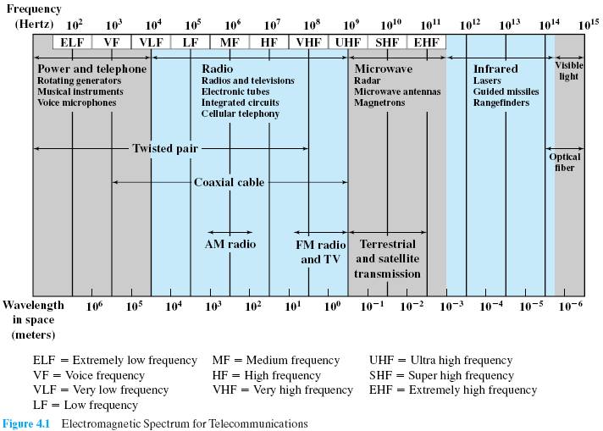
Electromagnetic Spectrum for Telecommunications
Notes:
In the VLF, LF, and MF bands, radio waves follow the curvature of the earth (ground waves).
In the HF band, they bounce off the ionosphere (refracted & reflected back).
The radio, microwave, infrared, and visible light portions of the spectrum can all be used for transmitting
information by modulating the amplitude, frequency, or phase of the waves.
Speed of electromagnetic radiation in free space (c) = 3.00 x 10⁸ m s⁻¹
Planck’s constant (h) = 6.63 x 10⁻³⁴ J s
Energy = h * f (energy of electromagnetic wave) quantum energy of a photon

Slide 42
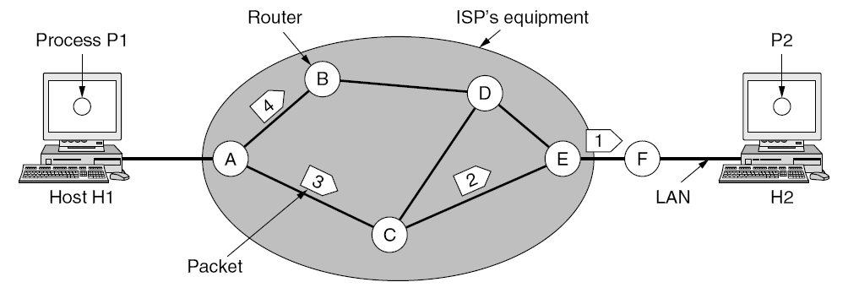
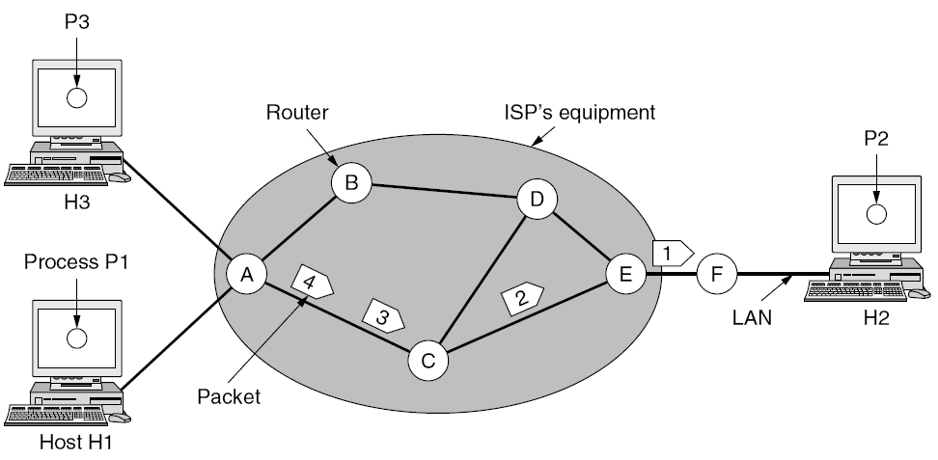
Routing within a datagram (packet switched)network.
Circuit switched network.
Notes:
In a circuit switched network a virtual circuit is established until all data is transmitted.
Thus, all packets will follow same single established path for the duration of transmission.
VPN (virtual private network) is a service provided by an ISP (ethio telecom)

Slide 43
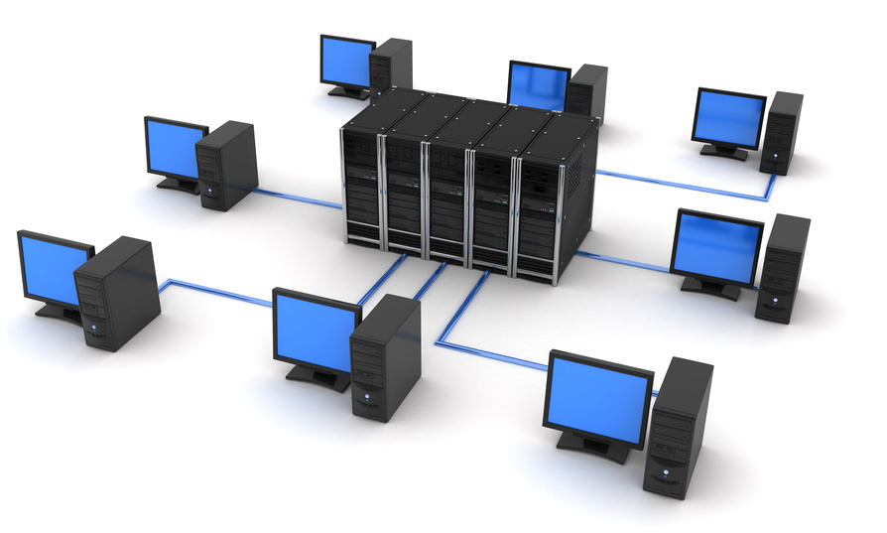
Computer Networks
A computer network is an interconnection of various computer systems located at different places.
Two or more computers and other peripheral or data communication devices linked together.
The computer that provides resources to other computers on a network is known as server.
In a network individual computers, which access shared network resources, are known as workstations or terminals or clients.
Networks must meet certain criteria, the most important are: Performance, reliability, and security.
Notes:
Two computers are said to be interconnected if they are able to exchange information.
Networking deals with the technology and architecture of communication networks used to interconnect communicating devices. LANs, WANs, and the building components (or devices).
What are the differences between a client and server computers? HW & SW differences.
Performance is related to efficiency, response time, bandwidth, etc.
How efficiently the desired results are achieved.
Reliability : Means "repeatability" or "consistency“, “Astemamagninet”.
→ Frequency of failure, recovery time of a network after failure
→ Has sub factors of maturity, availability, fault tolerance, and recoverability.
Security : Protecting data from unauthorized access

Slide 44
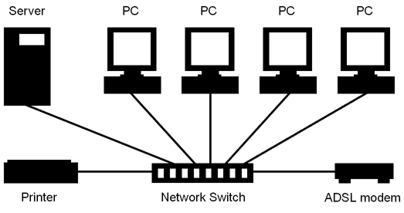
Why networking?
Remote access to resources – Efficiency through accessibility – Resource Sharing
Reduction of data duplication – Data kept on a Server
Communication (Collaboration)- people can work together in ways not previously possible (ARPANET)
Saving money (peer to peer (distributed computing))
Price / performance rate of a number of linked small computers is better than few large ones.
Better to get cheaper machines and network them.
scalability - ability to grow and shrink network capacity
Notes:
Resource Sharing : Printer and Internet access sharing as can be seen in the diagram
Communication : Share information (email, video conferencing)
ARPANET: Advanced Research Projects Agency Network
For Electronic Business : Ecommerce (B2B, B2C, G2C)
Person-to-person communication : Email, video conferencing
Mainframes 1000 times more expensive but only 10 times more powerful.
Scalability : We can add more servers during peak ours, for example.

Slide 45
Networks for, Cont’d …
People use networks for
Access to remote information - for fun or information.
Banking services, marketing, online digital libraries, …
Person-to-person communication
Email, video conferencing
Interactive entertainment
Audio (music, radio, etc) and Video (movies, events, etc) on demand
Internet Access Sharing (resource sharing)

Slide 46
The Costs (Drawbacks) of Networking
Network Hardware, Software, and Setup Costs
Hardware and Software Management and Administration Costs
Undesirable Sharing
Illegal or Undesirable Behavior
Data Security Concerns
How can we be sure valuable information is safe in a networked environment?
Notes:
Wireless is highly vulnerable (exposed).
Network administrator required.
Can we keep information secret indefinitely? How?
As long as the subjects are restricted to technical topics or hobbies like gardening, not too
many problems will arise.
The trouble comes with topics that people actually care about, like politics,
religion, or sex.

Slide 47
Different ways of classifying networks
There is no generally accepted taxonomy into which all computer networks fit, but the following dimensions standout as important:
By Transmission Technologies
By Network Topology
By management Method
By Scale (Size)
Notes:
Transmission technologies point to point and broadcasting
Packet sent to all possible destinations - only receivers accepts - others discard
Packets can be addressed to all destinations - broadcasting
Packets can also be addressed to only a few of the possible destinations - multicasting
Normal for smaller networks - LANs
Normally, in broadcast networks, we can send to a particular machine (destination) by using the machine's address.
We also send to ALL machines by using a special agreed-on address (in broadcasting), or a set of machines, again using special addresses (in multicasting).
The reason why this type is usually only used in smaller networks is because it can generate a huge amount of unnecessary network traffic.

Slide 48
Ways of classifying networks Cont’d …
Depending on one’s perspective, we can classify networks in different ways
Based on transmission media: Wired (UTP, coaxial cables, fiber-optic cables) and Wireless
Based on network size: LAN and WAN (and MAN)
Based on management method: Peer-to-peer or Client/Server
Based on topology (connectivity): Bus, Star, Ring …

Slide 49
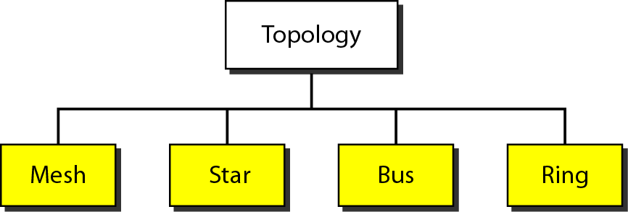
Topology of Networks
The logical layout, or shape, of a network is called topology.
Some of the basic topologies:
Star
Ring
Bus
Mesh/Complete
Details are left as a Reading Assignment for you!
Notes:
Topology: Physical (geometric arrangement) of computers in a network.
** Wireless can also be included as a fifth topology. (WiFi, forexample)

Slide 50
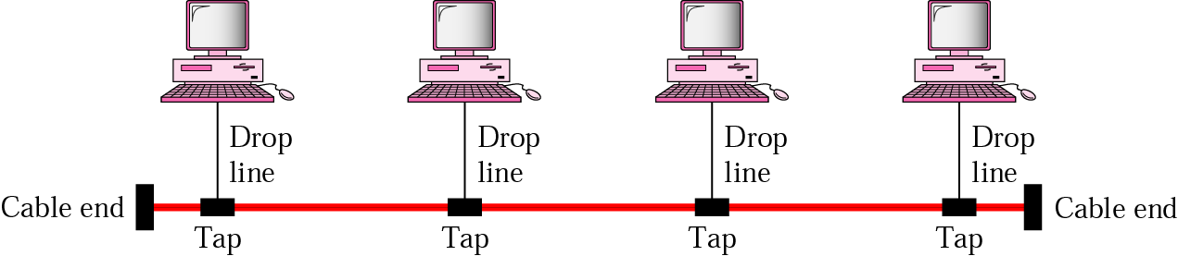
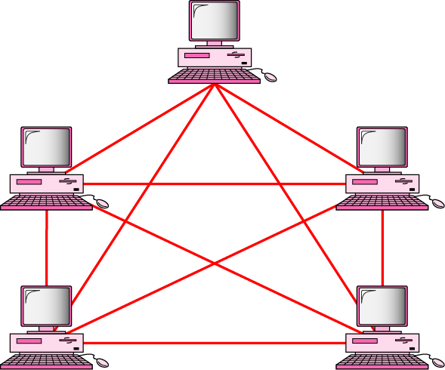
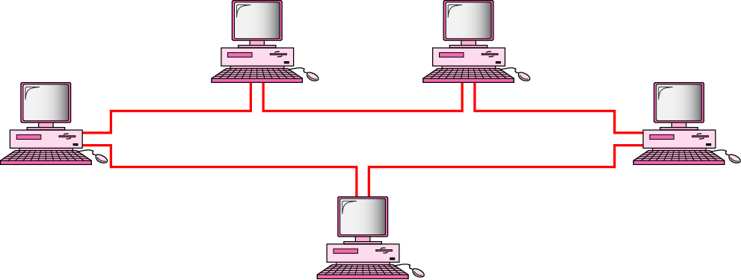
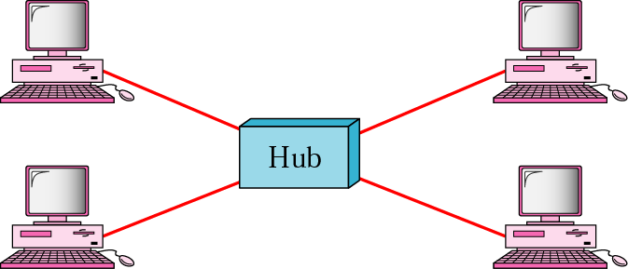
Mostly used network topologies
bus
mesh
ring
Star (Most Commonly Used Type)
Notes:
N(N-1)/2
In Bus there is collision problem.
Ring no collision.

Slide 51
Topology Concerns
Performance issues
Reliability, Ability to recover through/after failure of one or more nodes
Physical constraints
Transmission speed, distance between nodes
In a LAN 100 meters is maximum distance to connect two LAN segments using twisted pair cable (or two switches).
Other issues
Susceptibility / Vulnerability to errors
Growth of the network (Scalability)
Capability and types of equipment the network needs
Cost, geographical area (network size)
Notes:
When choosing topology we should assess topology concerns.
Reliability : Means "repeatability" or "consistency".
→ Frequency of failure, recovery time of a network after failure
→ Has sub factors of maturity, availability, fault tolerance, and recoverability.

Slide 52
Star Topology
A number of workstations (or nodes) are directly linked to a central node called a hub.
Any communication between stations on a star LAN must pass through the central node.
There is bi-directional communication between various nodes (full duplex).
The central node controls all the activities of the nodes.
Cable segments from each computer are connected to a centralized component.
Notes:
The advantages of the star topology are:
➔ It offers flexibility of adding or removing of workstations from the network.
➔ Easy to add and remove machines, since we only need to hook them up to a central hub
➔ Breakdown of one station does not affect any other device on the network.
➔ It is robust since no machine depends on other machines.
Disadvantage are :
➔ Single point of Failure because of the hub or switch.
➔ Requires more cabling than bus or ring.

Slide 53
Cont…
The advantages of the star topology are:
It offers flexibility of adding or removing of workstations from the network.
Easy to add and remove machines, since we only need to hook them up to a central hub
Breakdown of one station does not affect any other device on the network.
It is robust since no machine depends on other machines.

Slide 54
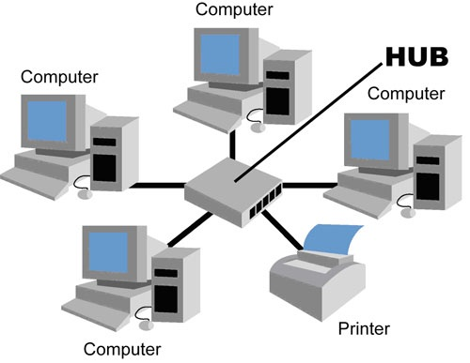
Cont…
The major disadvantage of star topology is that
Failure of the central node disables communication throughout the whole network.
It requires relatively more cabling than the Bus or Ring.
Notes:
Single point of failure

Slide 55
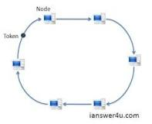
Ring Topology
Each station is attached to a nearby stations on a point to point basis so that the entire system is in the form of a Ring.
Data is transmitted mostly in one direction only or in recent designs both directions.
Thus the data packets circulate along the ring in either clockwise or anti-clockwise uni-direction in a closed loop and passes through each computer.
The failure of one computer can take down the entire network.
If a node goes down entire network goes down (single point of failure).
Notes:
A ring topology is easy to install, but uses expensive parts. It is easy to add a new machine.
Token Ring Networks Protocol (Token Ring Protocol) :
➔ Electronic token travels around the circuit
➔ If Token is empty then data can be loaded and then offloaded at the destination node
➔ Reduced or no chances of collision as compared to Star and Bus

Slide 56
Token Ring (protocol)
A ring topology is easy to install, but uses expensive parts. It is easy to add a new machine.
Token Ring Networks
Electronic token travels around the circuit
If Token is empty then data can be loaded and then offloaded at the destination node
Reduced or no chances of collision as compared to Star and Bus
An example is IBM’s token ring network

Slide 57
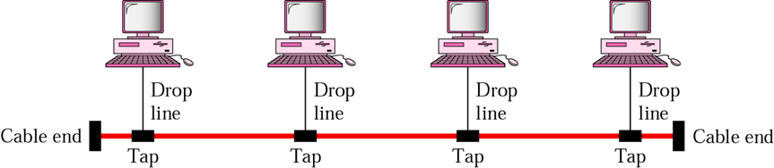
Bus Topology
In bus topology all workstations are connected to a single communication line called bus.
In this type of network topology there is no central node as in star topology.
All nodes compete for the use of the BUS
Notes:
The advantage of the bus topology is that it is quite easy to set up.
Transmission is like broadcast and received by all workstations.
If one station of the topology fails it does not affect the entire system.
The disadvantage of bus topology is that any break in the bus may break the entire network.
A bus topology is also easy and low cost to install.
The cable end is sealed with a Terminator.

Slide 58
Bus Cont…
Transmission from any station travels the length of the bus in both directions and can be received by all workstations.
The advantage of the bus topology is that it is quite easy to set up.

Slide 59
Bus Cont…
If one station of the topology fails it does not affect the entire system.
The disadvantage of bus topology is that any break in the bus may break the entire network.
All messages are transmitted to the whole network
A bus topology is also easy and low cost to install.

Slide 60
Complete/Mesh Topology
A complete topology is very robust, since every machine has connection to every other machine, so doesn't depend on other machines.
It is more secure since we don't have to send data through intermediate machines. But the drawback is the amount of cabling that it needs.
Also, adding and configuring a new machine is very cumbersome.
Notes:
N(N-1)/2 connections

Slide 61
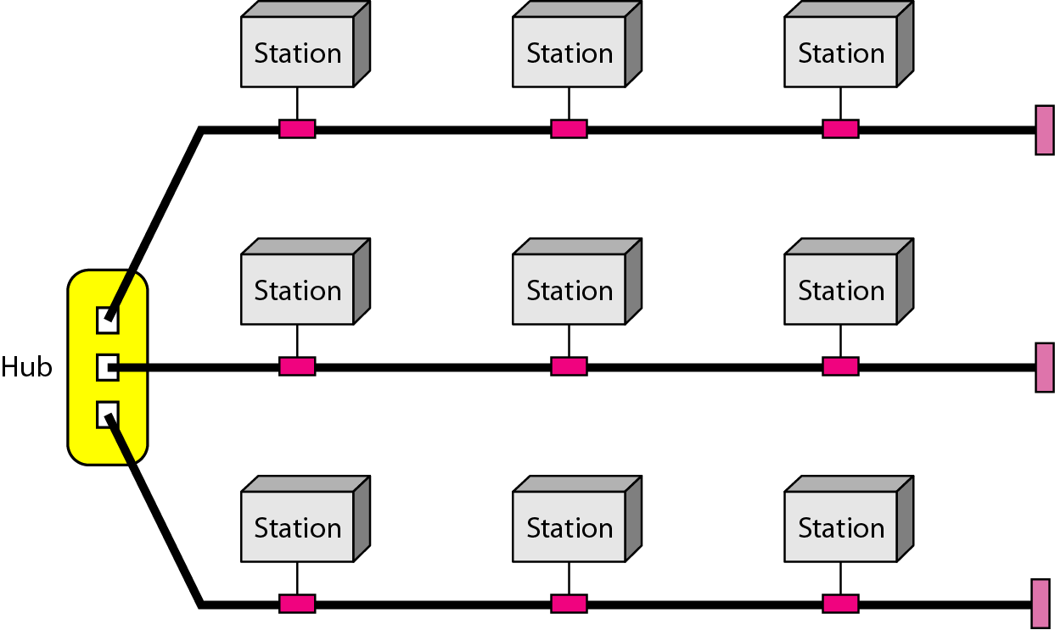
A hybrid topology: a star backbone with three bus networks
Notes:
What is a backbone? A backbone can be considered like a ring road or highway with high volume traffic capacity in a road network.
What can you say about the backbone of the internet? It is the core of the internet.
What devices do you think are employed to build the backbone of the internet?

Slide 62
Comparison of Network topologies
Advantages and Disadvantages of Network Topologies
Topology | Advantages | Disadvantages
Bus | Cheap. Easy to install. Takes less cable | Difficult to reconfigure. Break in bus disables entire network.
Star | Cheap. Easy to install. Easy to reconfigure. Fault tolerant. Most common. | More expensive than bus. Failure of the central node disables communication throughout the whole network.
Ring | Efficient. Easy to install. | Reconfiguration difficult. If one node fails the whole network will fail. Very expensive.
Mesh | Most fault tolerant. | Reconfiguration extremely difficult. Extremely expensive. Very complex.
Notes:
Reconfiguration: Changing the setup or Moving the network somewhere

Slide 63
Network Types Based on Management Method
Two major types of networks
Peer-to-peer (P2P)
File sharing (e.g. BitTorrent)
Internet telephony (e.g. Skype)
In a peer-to-peer system there are no fixed clients and servers.
Client/Server (also called server-based)
Notes:
Standalone → Client Server → Peer to Peer
Not networked → Networked (thin client) → Fat client (Networked and Distributed)
Advantages of client/server: Cheaper to change and upgrade software on a server, as there is no need to install the software on every PC.
Advantages of peer to peer: More power from the combined peer effect with very less cost, by harnessing network bandwidth (distributed computing)

Slide 64
Network Classification based on Scale
Local Area Networks (LANs)
Metropolitan Area Networks (MANs)
Wide Area Networks (WANs)
Internet – The World’s Largest Network of Networks
Notes:
Internet : The largest wide area network.

Slide 65
Network Classification based on Scale
There is no hard and fast rule on how big a network is before it becomes a LAN, MAN or WAN.
E.g. a LAN is usually identified by either all machines using the same LAN protocol (e.g. IEEE 802.3 Ethernet), or they are machines communicating within the same organization or within 1KM area.
Notes:
LANs operate at the data link and physical layers.
Type of other technologies used can also indicate whether network is WAN, LAN, or MAN.
It is possible to have machines on opposite parts of the world communicating over the same LAN protocol, which make them belong to a LAN. This is of course not good technically, since LAN protocols were designed for small networks.

Slide 66
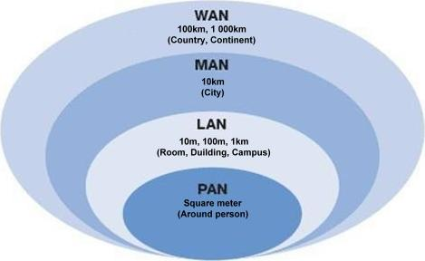
Based on Scale (Network Size) Cont…
(Room, Building, Campus)
(Around a person)
Notes:
Personal area networks are wireless (due to recent technologies).
Body area network (BAN) also known as wireless body area network (WBAN) or a body sensor network (BSN), is a wireless network of wearable computing devices.
WiFi is wireless local area network (uses CSMA/CA protocol)
WiFi (CSMA/CA) is like a crossroad with no traffic light where cars need to check and make sure no-one else is crossing before moving on, While WiMAX is when you have a traffic police (the base station) giving turn to each car to pass.

Slide 67
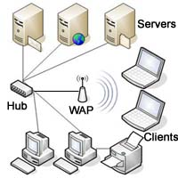
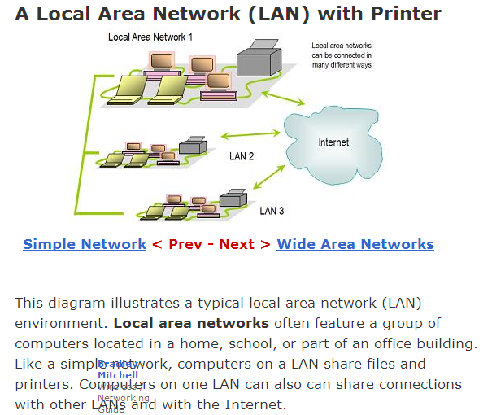
Local Area Network (LAN)
Network of computers located in a single location, like a home, school, or office building
Can share connection to the internet with other LANs
Notes:
Servers can be file server, application server, webserver, or other
LANs are the building blocks of wide area networks.
WAP bridges wireless and wired connections
WiFi short range while WiMax is long range

Slide 68
Setting up home networks (LAN)
Two or more computers (with NIC)
Cable (UTP or STP)
Connectors(RJ-45)
Switch (or Hub)
Network operating Systems
Configure each computer (assign IP, …)
An ISP (for Internet access)
Notes:
MAC Address is also called Ethernet address.
In the case of Ethernet, every NIC ever manufactured comes equipped with a unique 48-bit Ethernet address. Manufacturers of Ethernet NICs request a block of Ethernet addresses from IEEE to ensure that no two NICs have the same address (to avoid conflicts should the two NICs ever appear on the same LAN).
WiMAX stands for “Worldwide Interoperability for Microwave Access” and is a standard-based
technology for providing a wireless alternative to cable and DSL connections.
WiFi (CSMA/CA) is like a crossroad with no traffic light where cars need to check and make sure no-one else is crossing before moving on, While WiMAX is when you have a traffic police (the base station) giving turn to each car to pass.

Slide 69
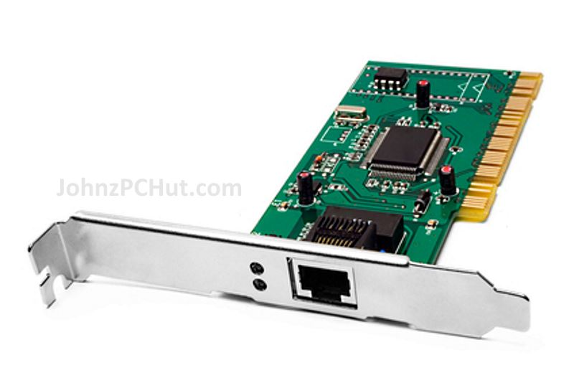
Network Medium Carries Network Messages
Computers share access to common network medium that carries signals from one computer to another
Medium may be physical cable, such as twisted pair, coaxial, or fiber-optic
Medium may be wireless
Physical interface to medium is usually network interface card (NIC) or network adapter
Kind of medium dictates type of connector and limits number and type of devices as well as distance a single LAN can span

Slide 70
Extending a LAN
To alleviate the distance limitation of LAN
Methods Available
Repeaters: (physical layer devices)
tap into the network and boost the signal
Connect two LAN segments
Correct, regenerate, and forward the signal (Can't correct collision)
Amplifiers and repeaters belong to the physical layer of the OSI model
Amplifiers forward noise and collision as well
Repeaters try to correct distortion due to noise, while amplifiers don’t.
Notes:
What is the difference between amplifiers and repeaters?
Hubs are multiport repeaters.
Attenuation=reduction to strength of signals due to long distance transmission
A repeater is a physical layer device that receives, amplifies (i.e., regenerates), and retransmits signals.
Repeaters can correct distortion due to noise, while amplifiers can’t.
At the bottom, in the physical layer, we find the repeaters. These are analog devices
that work with signals on the cables to which they are connected. A signal appearing
on one cable is cleaned up, amplified, and put out on another cable. Repeaters do not
understand frames, packets, or headers. They understand the symbols that encode bits as volts.

Slide 71
Repeater…
Hub
Hubs are actually multiport repeaters.
Hubs are layer 1 devices (physical layer devices).
In many cases, the difference between the two devices is the number of ports that each provides.
While a typical repeater has just two ports, a hub generally has from four to twenty-four ports
Repeats input to all other ports
A signal appearing on one cable is cleaned up, amplified, and put out on another cable.
Notes:
At the bottom, in the physical layer, we find the repeaters. These are analog devices
that work with signals on the cables to which they are connected. A signal appearing
on one cable is cleaned up, amplified, and put out on another cable. Repeaters do not
understand frames, packets, or headers. They understand the symbols that encode bits as volts.
Application Layer >> Message
Transport Layer >> Segments PPP: Point to Point Protocol
Network Layer >> Packets SNMP: Simple Network Management Protocol
Data Link Layer >> Frames
Physical Layer >> Bits

Slide 72
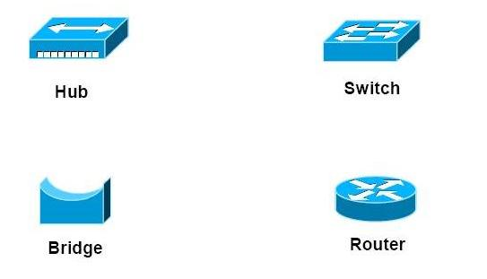
Cont…
The devices that are used to connect network segments include bridges, switches, routers, and gateways.
Notes:
Hubs are actually multiport repeaters.
Repeaters (Hubs) do not understand frames, packets, or headers.
No addressing for a hub or repeater (layer 1 device).
At the bottom, in the physical layer, we find the repeaters.
These are analog devices that work with signals on the cables to which they are connected.
A signal appearing on one cable is cleaned up, amplified, and put out on another cable.

Slide 73
Cont…
Bridges:
Store frames from one LAN and sends to another.
The function of the bridge is to make intelligent decisions about whether or not to pass signals on to the next segment of a network
Slows down transmission speed and has potential for bottlenecks
Do not forward noise and collision
Uses computer MAC address (Physical address)
Bridges are layer 2 devices (Data link layer devices).
Notes:
Bridges are self-learning
Store and forward = buffer
Makes decisions = Uses some algorithm (can be implemented in hardware)

Slide 74
Cont…
Switch (Ethernet switch)
Is more intelligent than a hub
A switch is sometimes described as a multiport bridge
While a typical bridge may have just two ports linking two network segments, a switch can have multiple ports depending on how many network segments are to be linked
Bridges and Switches are PnP (plug and play devices) while Routers are Configurable.
Notes:
A switch is a multiport bridge, while a hub is multiport repeater.
Bridges and Switches are Self-Learning
PnP = No manual configuration required (automatically configured by themselves or by the underlying structure)

Slide 75
Cont…
Gateway
stores and sends segments & messages to different networks that use different protocols. It is located at network perimeters. They are layer 4 and above devices (ex. SMS gateway)
Router
Routers are responsible for routing data packets from source to destination within a LAN comprised of different networks, and for providing connectivity to a WAN.
In order to provide these services the router must be connected to the LAN and WAN.
A router at the perimeter of a network , connecting a LAN to a WAN, is essentially a gateway.
Routers are Layer 3, network layer devices (uses IP address also called logical address)
Notes:
If devices can store and forward frames or packets and form tables, what HW should they have?
A network device that connects networks that use different protocols is a gateway.
A router connects two networks using same network protocols.
Transport Gateway : Reformats packets as needed by connecting two networks using different transport protocols.
Application Gateway : Understands the format and content of the data and translates massages from one format to another. An email gateway could translate Internet messages into SMS messages for mobile phones, for example.
In the previous slide, if the departments have different network addresses, the bridge should be replaced by a Router!
Routers are not plug and play (not PnP).
Gateway refers to a forwarding process that runs at a higher layer.

Slide 76
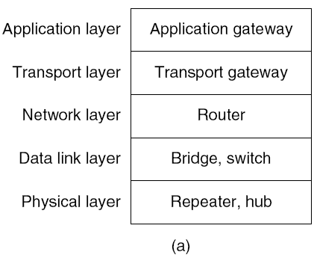
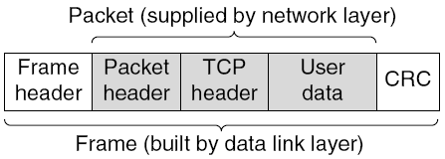

Which device is in which layer.
Frames, packets, and headers.
Notes:
CRC : Cyclic Redundancy Check ; An error correction information (What we have called encapsulation)
At the bottom, in the physical layer, we find the repeaters. These are analog devices
that work with signals on the cables to which they are connected. A signal appearing
on one cable is cleaned up, amplified, and put out on another cable. Repeaters do not
understand frames, packets, or headers. They understand the symbols that encode bits as volts.

Slide 77
Metropolitan Area Networks (MANs)
Similar technology to a LAN but over a wider area (e.g. city)
Utilize microwave, optical fiber, other wires; Wired or wireless
Different communicating LANs in a city can form MAN.
MAN is a type of WAN
Notes:
In a LAN because the computers are near to each other,
they may be limited to cable communication.

Slide 78
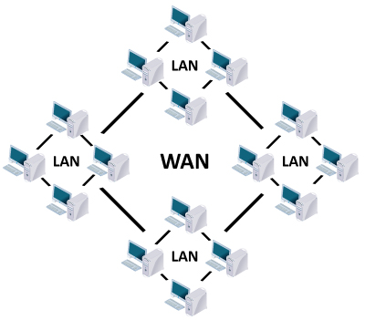
Wide Area Network (WAN)
Network over a large area like a city, a country, or multiple countries
Connects multiple LANs together
Generally utilizes different and much more expensive networking equipment than LANs
The internet is the most popular WAN (Largest WAN)
Notes:
WANs use all types of technologies including satellites.
LANs are the building blocks of wide area networks.

Slide 79
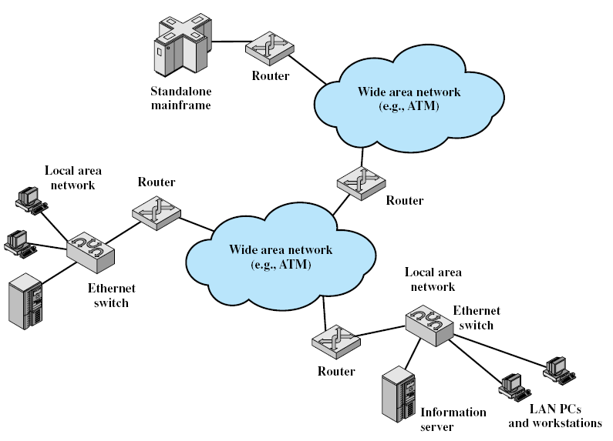
Key Elements of the Internet
Notes:
The cloud is a metaphor for the internet.
Routers are the main devices of the Internet.
ATM is a data link layer protocol that uses fixed-length cells rather than frames.
ATM: Asynchronous transfer mode (protocol)
➔ Asynchronous + Circuit switched (virtual circuit)
➔ Quality of service (better QOS than other current protocols)

Slide 80
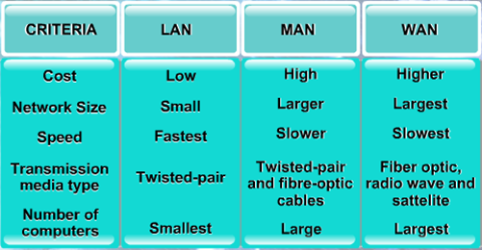
Comparing LAN, MAN, and WAN

Slide 81
Domain Name System
The domain name system (DNS) is chiefly used to translate hostnames into numeric IP addresses
DNS is an example of a distributed database
If that server can resolve the hostname, it does so
If not, that server asks another domain name server
Recursive resolution of host name to IP address
Notes:
https://www.yahoo.com
Domain name of yahoo (memory aid to easily remember the address)
Host name = Domain name
Windows\system32\drivers\etc\hosts = Internal DNS table
An application program (such as HTTP, SMTP, and FTP) needs the services of another program for this; this application program is called DNS-Domain Name System (runs over UDP and uses port 53); i.e., it is an application-layer protocol

Slide 82
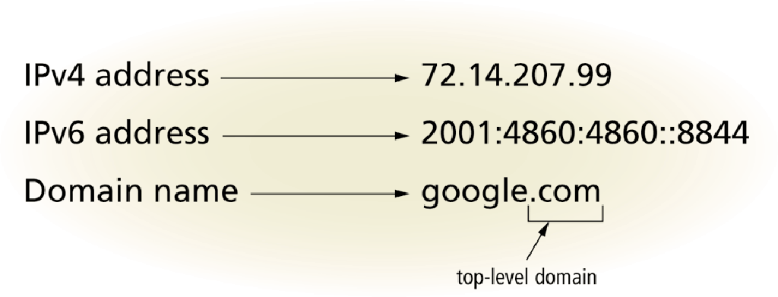
Connecting to the Internet
An IP address is a sequence of numbers that uniquely identifies each computer or device connected to the Internet
A domain name is a text-based name that corresponds to the IP address
A DNS server translates the domain name into its associated IP address
IPv4 address uses 32 bits
IPv6 address uses 128 bits
Notes:
IPv4 address: Four Octets: Four 8 bit pairs
Domain name or Host name
2¹²⁸ possible ip addresses for IPv6
What are the appropriate questions in the age of IOT?

Slide 83
WWW - Internet
Internet is a worldwide network of networks, linking computers to computers and other devices .
It is publicly accessible network of interconnected computer networks that transmit data by packet switching using the standard Internet Protocol (IP).
Some one can use one or all of the following Internet services:
mail (e-mail).
Telnet or remote login.
FTP or File Transfer Protocol.
The World Wide Web (WWW or "the Web")
The interlinked Web pages and other documents of WWW functions using HTML and other programming embedded within HTML that make possible hypertext. Linked by hyperlinks and URL.
Cloud computing
Notes:
The Web is a global library that is steadily growing in the depth and breadth of its contents
Cloud computing is one of the services of the Internet.
The cloud is essentially the Internet.
Thus, Cloud computing is a service of the Cloud.
The “cloud” is a metaphor for the Internet; a cloud-like shape is often used to depict its complex infrastructure.
SAAS, PAAS, IAAS: Services of the internet

Slide 84

Cloud computing stack: IaaS, PaaS, and SaaS.
Widely used examples of SaaS include web-based mail systems, such as Yahoo and Gmail, and office applications, such as Google Docs and Office 365.
Notes:
Cloud services are provided like other utility services: Electricity, telephone, and water
Cloud Service Delivery Model (Cloud Computing Architecture)
The cloud is essentially the Internet.
SaaS is also known as “on-demand software.”
Email is an example of SaaS
Virtualization is about detaching software from hardware
In a virtual environment, you can move the whole OS and its contents somewhere else.
Mazda, for instance, once had 200 physical servers in its data center, but the company used virtualization to knock that number down to just 28 servers hosting 490 virtual machines.
Cost-cutting approach to servers in which multiple operating systems run concurrently on a single physical PC server.
Patricia Wallace, Introduction to Information Systems, Page 82 & 83.

Slide 85
Intranet and Extranet
Intranet
Is a private network that uses Internet software and TCP/IP protocols
In essence it is a private internet
Important means of application delivery
Powered by internal web server
Notes:
What is the difference between a LAN and Intranet?
For example, Moodle and other information systems
Like HSIS can be implemented in an intranet.
Uses routers to connect a number of heterogeneous LANs
Extranet is an extended Intranet.

Slide 86
Cont…
Extranet
Is a type of inter-organizational information system
Enables people who are located outside a company to work together with the company’s internally located employees.
Aimed to connect business partners over the internet by using part of their private network
It comes from extended intranet
Closed to the general public, only for selected partners.
Notes:
VPN can be used to securely connect external partners or branch offices
Main objective is to foster collaboration between business partners
e
VPN : Virtual Private Network

Slide 87
To do list (Reading Assignment)
Read and take notes of
Web 2.0, Web 3.0
Next Generation Internet
Mobile Internet
Value Added Network
Semantic Web
Cloud Computing

